Slide 1
CF Final Project - “Food Recommender System”
Group No. 2
Abhinay Gupta BTech (2018209)
Shaney Waris BTech (2018308)
Waquar Shamsi MTech (MT20073)

Slide 2
About our CF Final Project
We have done both, Papers Implementations and Surveys.
We have Implemented 3 different papers as of now and tested on various different food recommender datasets available on the Internet.
We have implemented all three papers from the scratch, no code was available for those papers on the Internet.
We have also done survey on 15 different papers including the ones which we have implemented. We will extend this number in the next deadline.
We took latest papers from 2020-2021 published in various top conferences.
We got papers from the IEEE/ACM digital library websites.

Slide 3
Various Datasets we have used.
Amazon “Fine Food” dataset.
Link: https://snap.stanford.edu/data/web-FineFoods.html
“Raw Data Interaction” dataset from the kaggle’s competition.
Link: https://www.kaggle.com/elisaxxygao/foodrecsysv1?select=raw-data_recipe.csv
“Reviews” dataset from food.com
Link: https://www.kaggle.com/irkaal/foodcom-recipes-and-reviews?select=reviews.csv

Slide 4
Papers Implementation

Slide 5
Paper 1: With Implementation
Paper Title: Collaborative Filtering Recommendation Algorithm based on Improved Similarity.

Slide 6
Introduction
The traditional collaborative filtering recommendation algorithm can't measure well the similarity among users under the condition of data sparsity, which leads to a decrease in the accuracy of the recommendation system.
Hence, author propose a collaborative filtering algorithm to improve similarity.
Then weight the number of common scoring items on the similarity calculation to improve the shortcomings of the usual Pearson correlation coefficient.
Then, find the user's nearest neighbor set and predict the score of the item to generate a recommendation list.
Their algorithm increase the accuracy than those algorithms which uses cosine, jaccard similarity, to find the nearest neighbours.

Slide 7
Methodology
Step 1. Read users’ rating data
They have used Movielens dataset. But we will apply their algorithm in our different food recommender datasets.
Step 2. Create user-user similarity matrix with pearson correlation coefficient as a similarity measure.
This similarity may vary from -1 to 1.
Step 3: Now we create two one-dimensional arrays:
UserCount[]: which stores the total number of each user rating item.
Threshold[]: which stores the average of the number of items that the user rates with other users. For example, if user u and user v evaluate 7 items together, user u and user y evaluate 5 items together, then Threshold [u] = 6.

Slide 8
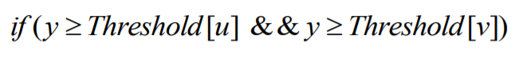
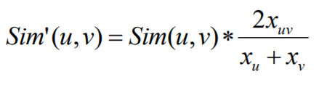
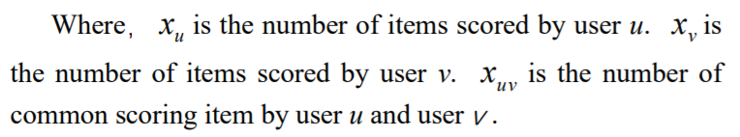
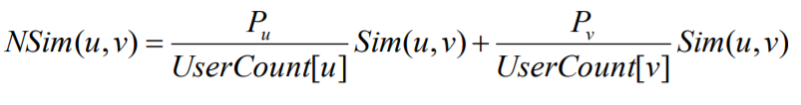
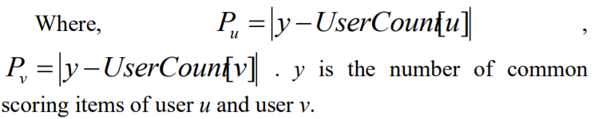
Methodology (contd.)
y = number of common scoring items y of both users u and v.
So, if the following condition satisfies,
Then similarity will be updated with the following formula in similarity matrix:
Else, the similarity will be update with the following formula in similarity matrix:
Step 4: Find k nearest neighbors of the user to form a recommendation list.

Slide 9
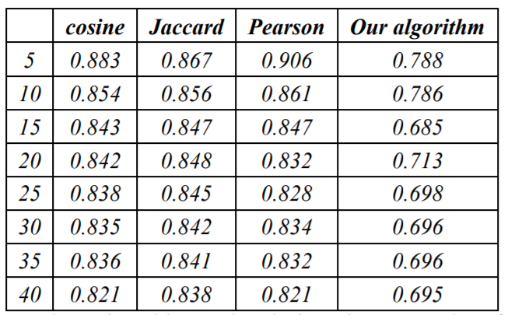
Results (Comparisons with other algorithms)
On the MovieLens Dataset
The comparison b/w this algorithm with the algorithms using Pearson similarity, cosine similarity and Jaccard similarity.
Size of the nearest neighbor k to 5 to 40, and each of 5 is a level.
This table shows the result of MAE for four algorithms.

Slide 10
Results (On 3 different food datasets)
On Amazon Fine Foods Dataset:
MAE = 0.49947657921027194 with Coverage = 91.43700787401575%
On Raw Data Interaction Dataset:
MAE = 0.7032586146672031 with Coverage = 82.23350253807106%
On Reviews Dataset (food.com):
MAE = 0.8067201122554294 with Coverage = 74.34624296590533%

Slide 11
Paper 2: With Implementation
Paper Title: Item-based Collaborative Filtering Algorithm Based on Group Weighted Rating

Slide 12
Introduction
Recommendation quality is seriously influenced by the sparsity of user ratings
To solve the problem, an improved item-based collaborative filtering algorithm based on group weighted rating is proposed.
The union of user rating items is used as the basis of similarity computing between items, moreover a group weighted rating method has been proposed to compute and complete the missing values in the union of user rating items for decreasing the sparsity.

Slide 13
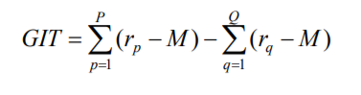
Methodology
Firstly, we will compute the GIT (Group Interest Trend).
Supposed that there has target user u ’s unrated item i in user-item ratings matrix R(mxn).
Firstly we denoted the rating set of all user for i as R = {R₁, R₂, …, R_{g}}.
Then we can select a subset, R_{p} = {R₁, R₂, …, R_{p}} in which the ratings are higher than the middle value M of R. M in the 5 rating scale will be 3.
Select another subset, R_{q} = {R₁, R₂, …, R_{q}} in which the ratings are lower than M.
GIT can be computed by the following equation:

Slide 14
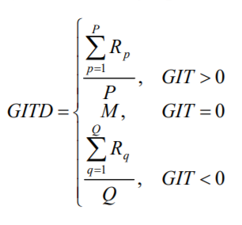
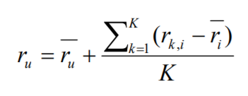
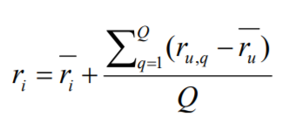
Methodology (contd.)
Now, we will compute the GITD (Group Interest Trend Degree) for each item.
And calculate:

Slide 15
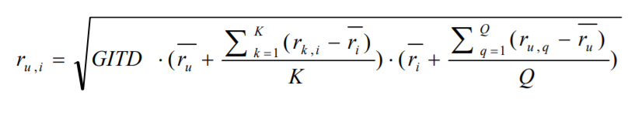
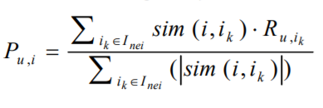
Methodology (contd.)
The the unrated item will be filled with the following formula:
Computer the similarity between the items.
Find the top K recommendation on the basis of similarity and predict the rating based on following formula:

Slide 16
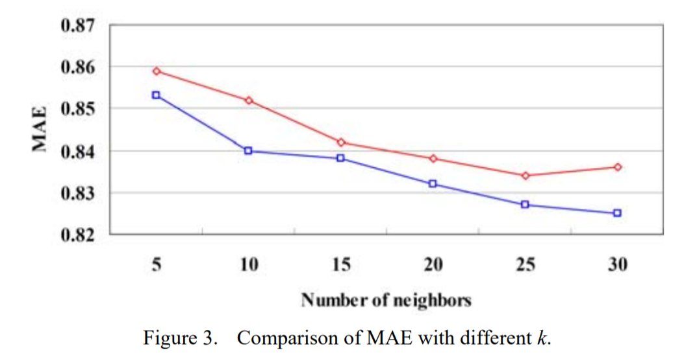
Results
MAE metric is used.
Author algorithm denoted as denoted as blue line.
Traditional item-based collaborative filtering algorithm denoted as red line.
We can clearly see that author algorithm beats traditional item based algorithm.
On the MovieLens Dataset

Slide 17
Results (On 3 different food datasets)
On Amazon Fine Foods Dataset:
MAE = 0.9419190572757882 with Coverage = 100%
On Raw Data Interaction Dataset:
MAE = 0.7094709059627913 with Coverage = 100%
On Reviews Dataset (food.com):
MAE = 0.8073645224326266 with Coverage = 100%

Slide 18
Paper 3: With Implementation
Paper Title: A Novel Similarity Measure to Identify Effective Similar Users in Recommender Systems.

Slide 19
Introduction
What? - A new collaborative filtering technique called Adaptive Similarity Measure Model [ASMM].
Why? - Improved user Similarity Measure.
Class of Technique: Neighborhood Approach

Slide 20
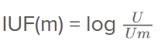
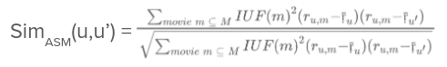
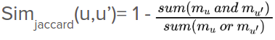
Methodology
To calculate the modified(custom) similarity, first calculate IUF
Find similarity between each pair of users using Modified Constrained Pearson Correlation Coefficient.
Find Jaccard Similarity between each pair of user using

Slide 21
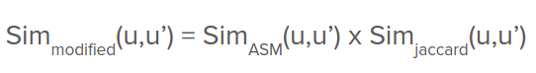
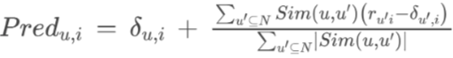
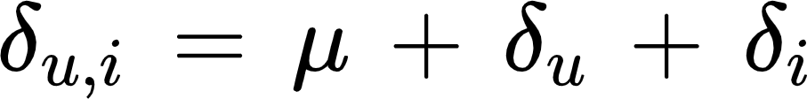
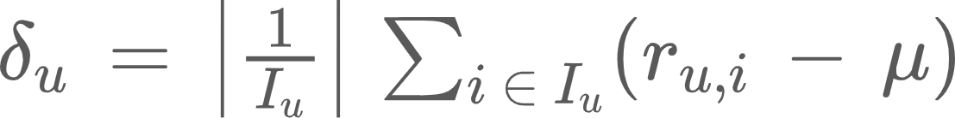
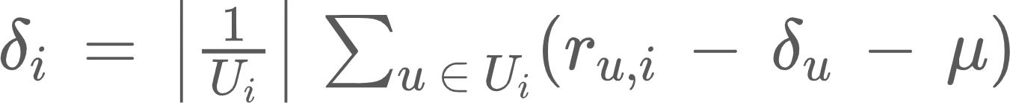
Methodology (contd.)
Calculate the final modified Similarity using
Then for each instance in the test set predict rating using

Slide 22
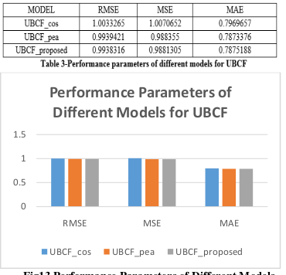
Results

Slide 23
Results (On 3 different food datasets)
On Amazon Fine Foods Dataset:
MAE = 0.987814950157182
On Raw Data Interaction Dataset:
MAE = 0.744742798799487
On Reviews Dataset (food.com):
MAE = 0.887674574834553

Slide 24
Survey’s

Slide 25
Paper 4
Paper Title: A Graph-based Recommender System for Food Products.

Slide 26
Introduction
Class of Technique: Neighborhood Approach
Recommendation: Top K Recommendations
Neighbourhood Graph
Similarity Based on Reviews
Similarity Using PageRank Algorithm

Slide 27
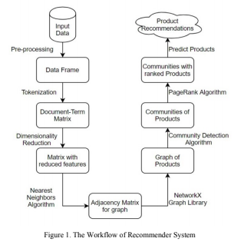
Methodology
Pre-process
Tokenization
Dimensionality Reduction
Neighbourhood Formation
Graph Generation
Community Detection
Ranking Products within Communities
Generating top K recommendations

Slide 28
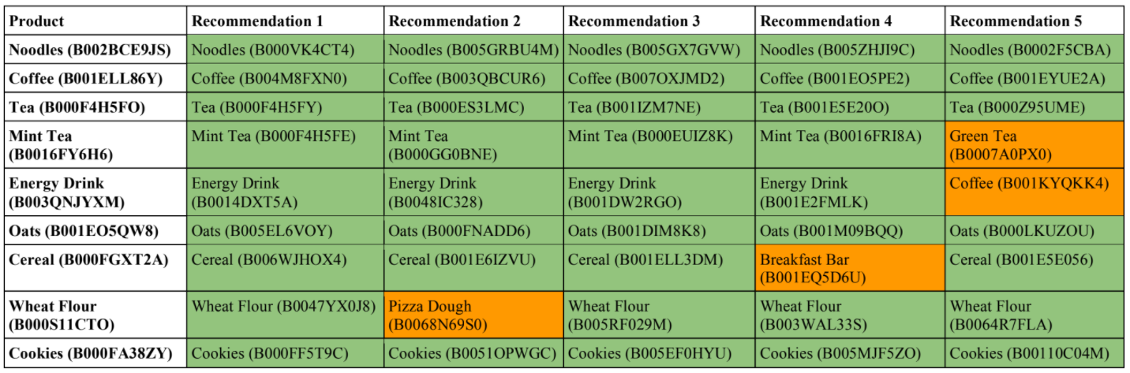
Results
Top 5 Recommendations generated for the products

Slide 29
Paper 5
Paper Title: Flavour Enhanced Food Recommendation.

Slide 30
Introduction
Idea: Use flavour as a feature to enhance recommendations
Motivation: In healthy food recommendation - recommended product may not suit the user’s taste
Approach: Content based filtering incorporating flavour.

Slide 31
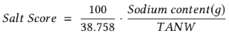
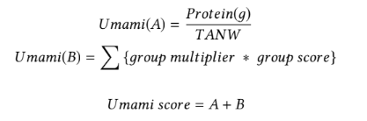
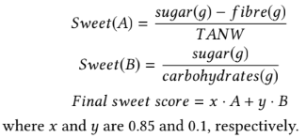
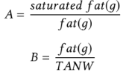
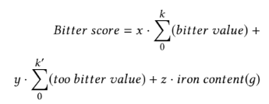
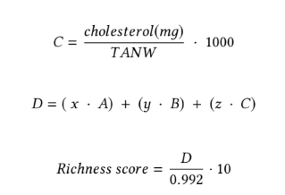
Implementation
Flavour Computing using biological information:

Slide 32
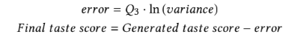
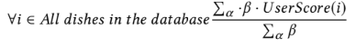
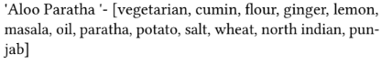
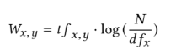
Implementation
Find error in taste score for food items using user survey
Associate food Items with Tags:
Calculate TF-IDF for tags using:
Generate Preference Score for unrated dish ‘i’ using:
Alpha = dishes rated by the user
Beta = cosine similarity between dish i and j

Slide 33
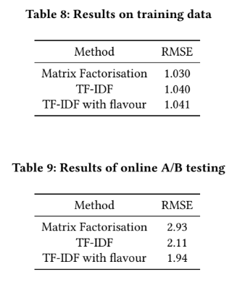
Results

Slide 34
Paper 6
Paper Title: Towards a Knowledge Aware Food Recommender System Exploiting Holistic User Model.

Slide 35
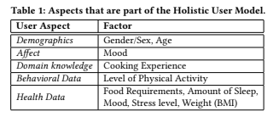
Introduction
Authors propose a recommendation strategy based on knowledge about food and user’s health related characteristics to generate personalized recipe suggestion
Use of several personal characteristics and contextual factors to help determine how appropriate a recipe is for a user

Slide 36
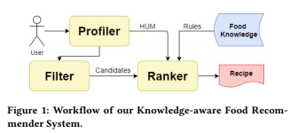
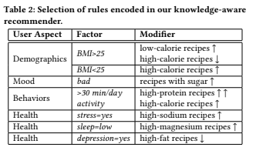
Implementation
Holistic User Model, is a representation of the user which consists of aspects such as demographics, interests, affects, knowledge and skills, psychological traits, behaviour, social connections and health data which can be obtained from smartphones or wearables.
For the paper it is assumed that such information is already available.

Slide 37
Implementation
First the user asks for a specific meal type:
Main course, Second course, or a Dessert.
Holistic User Model (HUM) is built for the target user.
Preliminary set of candidate recipes are generated and is filtered based on the user’s food restrictions and avoiding recipes which include certain ingredients.
Ranking of filtered candidate recipes by Ranker Component
Popularity based score: Holistic Scoring Function:

Slide 38
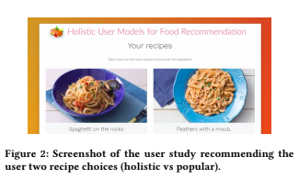
Evaluation and Results
200 participants use a web interface to select one of the two options
Food recommended based on popularity
Food recommended based on HUM
Observations:
People were most likely to choose popular recommendation
Except mood and gender none of the user aspects had much effect on the user’s choice.

Slide 39
Remarks
Use of more number of user aspects such as job profile and user’s personal goals may help achieve better recommendations
Non User based aspects such as weather, season and geographic location may help in achieving better recommendations as well.

Slide 40
Paper 7
Paper Title: Market2Dish: A health aware Food Recommendation System.

Slide 41
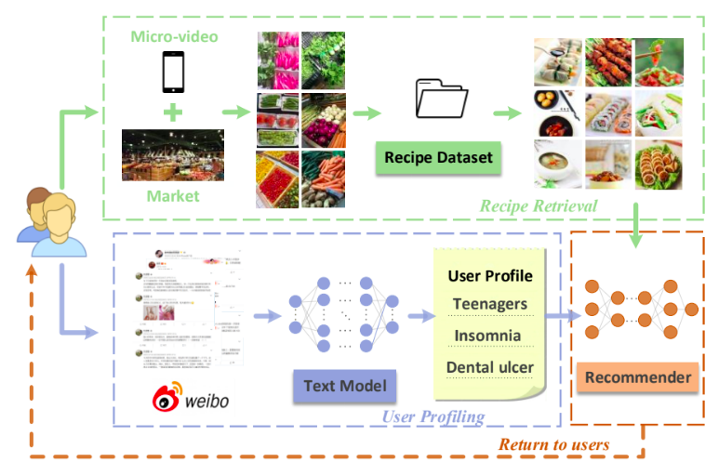
Concept
Authors propose generating healthy food recommendations using:
Health condition characteristic of users
Micro-videos of food items to recognize ingredients.

Slide 42
Paper 8
Paper Title: Personalized Food Recommendation as Constrained Question Answering over a Large-scale Food Knowledge Graph.

Slide 43
Introduction
A novel problem formulation for food recommendation, modeling this task as constrained question answering over a large-scale food knowledge base/graph (KBQA).
Additional Constraints to QA system: User’s dietary preferences and health guidelines.
Aim: Propose healthy recipes tailored to user’s preference and limitations

Slide 44
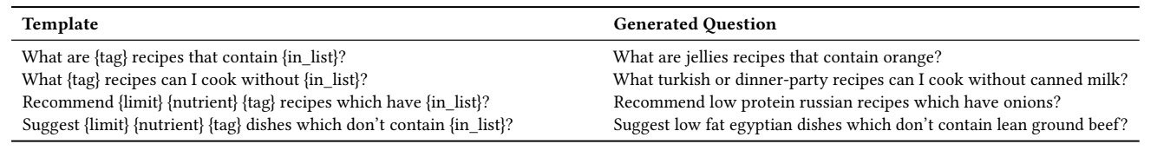
Implementation
A benchmark QA dataset is created with over 1 million recipes.
Each example in the dataset containing user query, dietary preferences, health guidelines associated with the user, and the ground-truth answers (i.e., recipe recommendations).
Template-based Natural Language Question Generation
56 different template questions

Slide 45
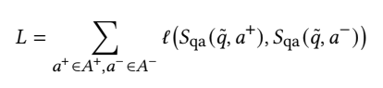
Implementation
Generating Dietary Preferences
Compiling Health Guidelines
Personalized Food Recommendation Framework(pFoodReq)
Query Expansion
KG Augmentation
Constraint Modelling
Training for answer to a query - Loss Function Used:
where l(y,yˆ) = max(0, 1 + yˆ − y) is a hinge loss function, and A+ and A- denote the positive and negative answer sets, respectively.

Slide 46
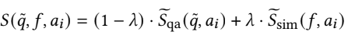
Implementation
Food Log Generation
Recipe Similarity
KG subgraph Expansion
Answer Ranking (overall score formula)
where λ is a hyperparameter for controlling the importance of recipe similarity.

Slide 47
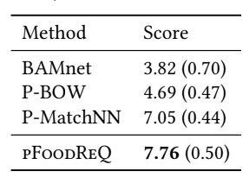
Experiment and Results
Human Evaluation of food recommendations is performed with 50 question from a randomized test, results obtained are:

Slide 48
Paper 9
Paper Title: Heterogeneous Fusion of Semantic and Collaborative Information for Visually-Aware Food Recommendation.

Slide 49
Introduction
Authors present a heterogeneous multi-task learning framework, termed privileged-channel infused network (PiNet).
Multi-Task: Ingredient Prediction and Food Recommendation
Recommendation Using : food images and user’s implicit feedback
Use of Dual Gating module
Use of unconventional food dataset - Chinese food dataset.

Slide 50
Implementation
Given user-item pair, first use an image encoder to extract visual features of i.
Then dual-gating module (DGM) re-attends the visual features based on the user embedding to obtain the item embedding.
Finally compute matching score according to conventional collaborative filtering algorithms.

Slide 51
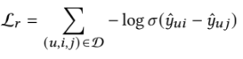
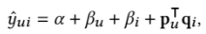
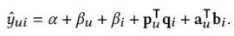
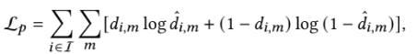
Implementation
Heterogeneous Multi-Task Learning, PiNet includes two channels
Task Channel: Computes preference score
There are two methods to calculate preference score:
Privileged Channel: receive item embeddings for ingredients prediction, aims to optimize the image encoder to encode semantic information

Slide 52
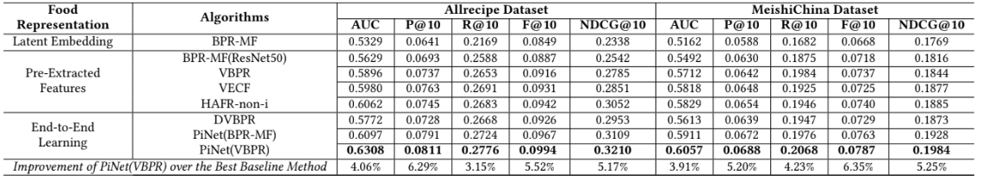
Experiment and Results
Evaluation Metrics: NDCG@k, F1 Score@k, Recall@k, Precision@k
For efficient Computation negative sampling is used considering high dimensionality of image features

Slide 53
Paper 10
Paper Title: Food Recommendation System for Meals-out in Nutrient Balance.

Slide 54
Introduction
The proposed system calculates the intake of nutrients and energies, and then recommends food for meals-out that support to adjust the nutrient balance.
The work incorporated food logs to make the recommendations.
To achieve the task of recommending foods while adjusting the nutritional balance, three functions are considered necessary:
Inputting Food Logs
Visualization of nutrient amount that a user has had
Recommendations of foods for to adjust the nutritional balance

Slide 55
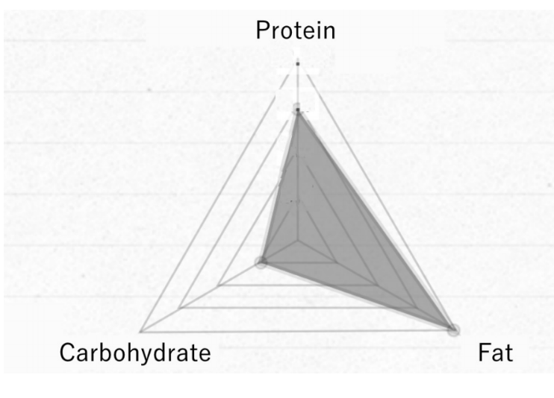
Implementation
Inputting Foods Logs: Since, input of food logs using images or video may be erroneous following alternatives are used
By Texting
By Choosing Options
By Scanning Receipts
Visualization:

Slide 56

Implementation
Procedure for the proposed system:
User inputs food log
Match input information with each record in database of foods
Obtain nutrient information of food and store in food logs
Calculate the amount of nutrients intake
Show a list of recommended foods to balance nutrient intake.
Input food logs store following information: userId, store/restaurant name, name of the food, size, date and time (had food), date and time(logged), amount of energy, amount of protein, amount of fat, amount of carbohydrate.
First five information are to be provided by user, rest are taken from prepared database.

Slide 57




Implementation
Calculating the amount of nutrient intake:
Detecting foods meeting the energy constraint:

Slide 58
Paper 11
Paper Title: Personalized Food Recommendation using Deep Neural Network.

Slide 59
Introduction
The paper proposed a temporal model of recommendation using deep neural network for Thai food.
Ingredients for the user’s favourite dishes are extracted.
Model predicts next dishes based on profile and eating history.

Slide 60

Implementation
Preference Classification
Set of ingredients is extracted from all recipes.
Ingredient group and its quantity are generated.
The quantity of the ingredient is represented as percentage by weight of the total dish portion.
Proposed Neural Architecture
The model predicts the user profile
Input layer is ingredient vector

Slide 61


Implementation
The recommendation score is computed by following equation:
Groups of Recommended Food:

Slide 62



Results

Slide 63
Paper 12
Paper Title: Ethics of Food Recommender Applications.

Slide 64
Introduction
Authors put forward eight needed ethical points for food recommender systems
Existing Applications
Ethical Content
Privacy
Autonomy and Personal Identity
Opacity
Fairness
Polarization and Social Manipulability
Robustness

Slide 65
Case Study: Evaluating Yuka
Product Assessment Approach
Technical Issues
Lack of explainability
Regarding Fairness
Disrupting the Food Industry

Slide 66
Paper 13
Paper Title: Clustering collaborative filtering recommendation algorithm of users based on time factor.

Slide 67
Introduction
In this novel algorithm, a time-based user clustering collaborative filtering recommendation algorithm is proposed.
There are three mainly improved steps in this novel algorithm.
Firstly, the user rating time is added to increase the similarity between users when users are clustered.
Secondly, in order to reduce the search space of similar users, only the nearest neighbor with a high similarity to the target user can be found in the cluster by adding the rating time.
Finally, the traditional collaborative filtering recommendation algorithm is used to recommend the target users in the clustered data set.
This is a technique tested on movielens dataset, but we can apply it on our different food dataset as well.

Slide 68

Methodology
Movielens dataset consists of four parts: user, item, rating and time.
Clustering users to reduce the calculation of nearest neighbors. Because the user's interest is changed with time, adding time factor for the user clustering to optimize the nearest neighbor.
Considering the user's interest changes with time, a time factor is added to the user cluster to optimize the selection of the nearest user.
The traditional clustering method ignores the time factor when clustering users, and the clustering results for users are shown as:

Slide 69

Methodology (contd.)
In this paper, it is proved that after adding the rating time the user’s clustering result is better than the traditional clustering result.
However, if the time is too accurate, the recommended accuracy will also be affected.
Therefore, in this paper, the time is accurate to the month, because the user's long-term interest will not change. But short-term interest will change with time.
After adding the time factor, the user clustering results are shown as:
We can clearly see in this table that after considering the time, the cluster number changes.

Slide 70


Results
MovieLens dataset was used to test the performance of the algorithm. It includes data sets of 100KB, 10MB and 1MB. This paper uses a 100KB data set for experiments, which includes 100,000 user ratings for 1,682 movies for 943 users.
To evaluate the performance of the algorithm, 80% of the data set was used as the training set and 20% was used as the test set.

Slide 71
Results (contd.)
It can be seen that the MAE and RMSE values of UCF, Kmeans_ucf and the algorithm proposed in this paper will decrease with the increase of the target users’ nearest neighbors number and gradually approach a stable value.
The algorithm proposed in this paper has significantly lower MAE values under different nearest neighbors than the other two algorithms.
Taking the nearest neighbor number 25 as an example, the MAE value of UCF is 0.757, and the MAE value of the proposed algorithm is 0.732, and the recommended effect is improved by 2.5%

Slide 72
Paper 14
Paper Title: Improved course recommendation algorithm based on collaborative filtering.

Slide 73
Introduction
This paper proposes a new novel recommended algorithm based on collaborative filtering for the course recommender to help student’s decision.
In this algorithm, the improved cosine similarity is used, according to the history of students' course selection records, and the better accuracy is obtained in the recommendation task, which meets the needs of users.
In addition, both text vector and user behavior record are used to improve the calculation of course similarity.
The experimental results show that the algorithm has a good effect on accuracy, recall rate and F1-score index.
We can easily apply their novel technique on our food datasets.

Slide 74


Methodology
They have used TF-IDF approach to calculate the similarity between the items.
The item data in the recommendation system is usually stored in the form of text.
TF-IDF is used to extract the text features of the project content, and vector space model is used to represent the text features.
TF (Term Frequency) =>
IDF (Inverse Document Frequency) =>

Slide 75


Methodology (contd.)
Finally, the TF-IDF value of the word t_{i} in a certain text d is obtained through:
Through the word segmentation, each text in the text set gets its own series of word strings, solves TF-IDF value of each word in the string, and then obtains the text vector of the text, for example, the text vector of the text p may be represented as:

Slide 76



Methodology (contd.)
Using the cosine similarity to calculates a set of text similarity of each text as a supplement course similarity.
Based on course collaborative filtering is improved on the similarity Where w_{ij} uses the improved cosine similarity shown as:

Slide 77


Results
It can be seen that our algorithm have achieved improved precision and recall rates than ItemCF and ItemIUF base on collaborative filtering algorithm of TF-IDF text similarity optimization.
F1-score results in different neighborhoods K for comparison.

Slide 78
Paper 15
Paper Title: Cuisine Recommendation, Classification and Review Analysis using Supervised Learning.

Slide 79
Introduction
Restaurant review analysis and cuisine recommendation proposed using SVM supervised learning algorithm and the functioning of the system analyzed.
The proposed method implemented, evaluated on the real world data set and an experimental results gives an average precision, recall and F1-score around 91% which shows the effectiveness of the system in recommendation of meal.
The technique described in this paper was tested on a food restaurant to recommend the food to their customers on their website.

Slide 80

Methodology
The Data-set contains 10000 reviews in text format in a “.csv” file which is taken from Yelp. This data-set is used for training the SVM classifier. It is split into 70% training data and 30% test data.
The data-set is cleaned from 10000 reviews to 4086 reviews and the reviews which are not proper are discarded from the data-set and then the Data-frame with bag of words model created then it is served as input to the vectorizer for further processing.

Slide 81
Methodology (contd.)
The SVM model after training will be deployed on the server which classify the reviews given by the customers into two classes positive and negative & give recommendations of the food to the customers according to the preferences set by them.
To train the model SVM classifier applied. There are two steps:
Finding how many items are similar in the database to the selected item.
To build a classifier, SVM uses linear function.

Slide 82

Results
3000 records used to test the model & the system is evaluated using different measures like precision, recall, F1-score.
Model Evaluation using different measures:

Slide 83
Future Work for “9th May 2021”
We will try to implement one more paper and will try to explore more food datasets available on the Internet.
We will do survey on 10 more different papers and will submit a final PDF file for our survey on all the papers.
BONUS (For Bonus Marks):
We will also create a Web Application with Flask backend and will try our best to host it on Heroku, else we will host it locally.

Slide 84
Thanks :D

